Slide 1

Tic Tac Toe

Slide 2
Submitted By
Rabia Sultana Aunti
ID: 20201019
Submitted To
Nahida Marzan
Lecturer
Department of CSE
University of Asia Pacific

Slide 3
Problem Statement
• Tic Tac Toe is a two-player game played on a 3×3 grid using X and O.
• Players take turns, and the goal is to make three same symbols in a row, column, or diagonal.
• The game is designed as an adversarial search problem where one player tries to win and the other tries to stop it.
• An AI player is developed using the minimax algorithm to choose the best move.
• Alpha-beta pruning is used to improve efficiency by reducing unnecessary calculations.
• The program runs in the console and supports Human vs Computer and Computer vs Computer modes.
• The board is printed after every move, and the game ends with a win or a draw.

Slide 4
Games, Rules, and Representation
Game:
Tic Tac Toe is a 2-player game (X and O).
Played on a 3×3 grid.
Rules:
Players take turns.
Move only in empty cells.
3 same symbols in row/column/diagonal = win.
Full board with no win = draw.
Representation:
Board stored as a list of 9 cells.
Each cell = empty, X, or O.
AI uses board state to choose best move.

Slide 5
Game Flow Diagram
Start
↓
Initialize empty board
↓
Display position guide (1–9)
↓
Select game mode
(Human vs Computer / Computer vs Computer)
↓
Assign symbols (X and O)
↓
Set search depth for AI
↓
Set current player = X
↓
WHILE game not over:
↓
Print current player
↓
IF Human turn:
Take input move
Validate move
ELSE (AI turn):
Use Minimax with Alpha-Beta
Select best move
↓
Update board
↓
Print board
↓
↓
Check winner?
YES → Display winner → END
↓
Check draw?
YES → Display draw → END
↓
Switch player (X ↔ O)
↓
End ┌ ─ ── ─ ── ─ ┼────--------─┐
Correct │ Wrong
▼ │ ▼
Update set │ Add to wrong set, check win
│ check attempts condition
│
│ remaining
│ │
└──────---------┼────--------─┘
│
┌───────---▼────────┐
│ Win or Lose? │
└─ ── ─ ─ ──┬────────┘
│
┌───▼─--─┐
│ End │
└───────┘

Slide 6
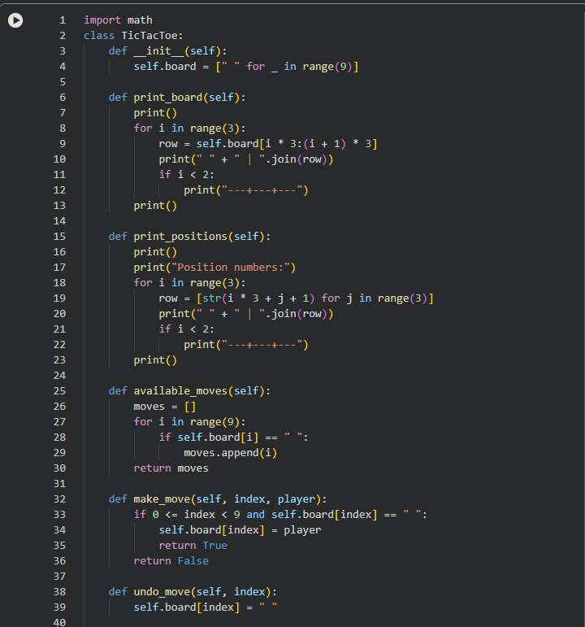
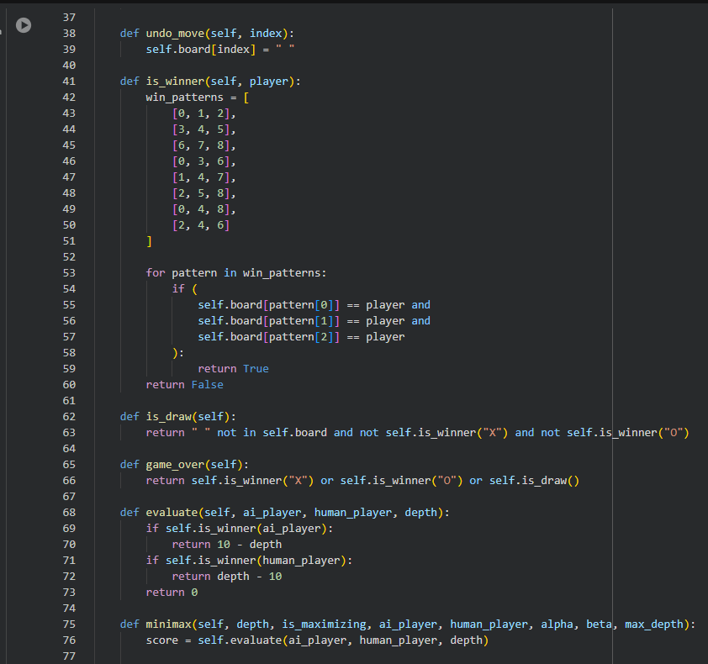
Source code highlight
Input:

Slide 7
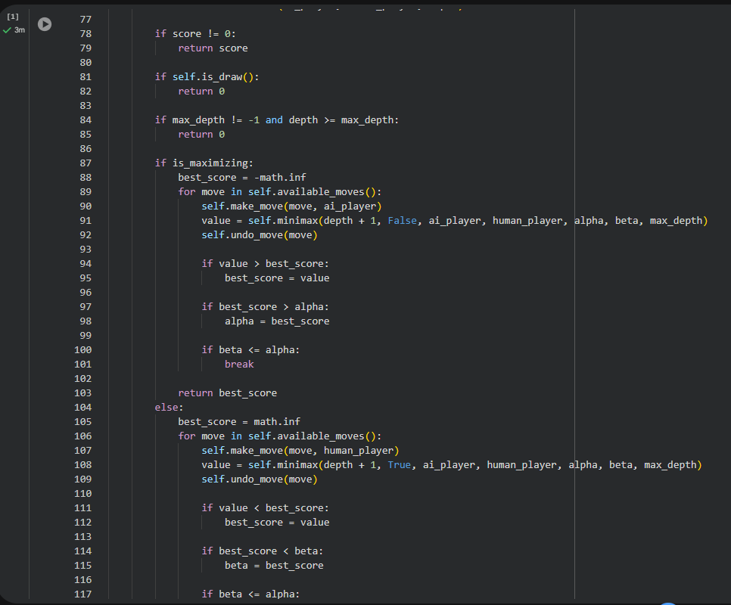
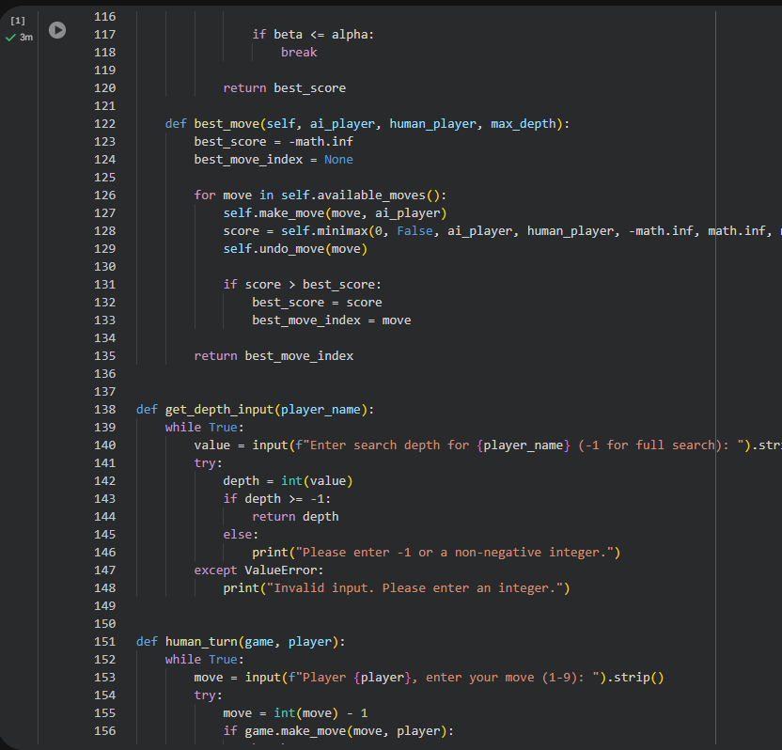

Slide 8
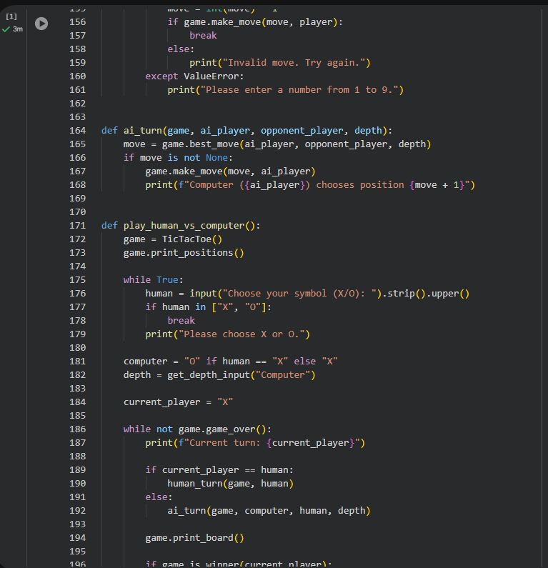
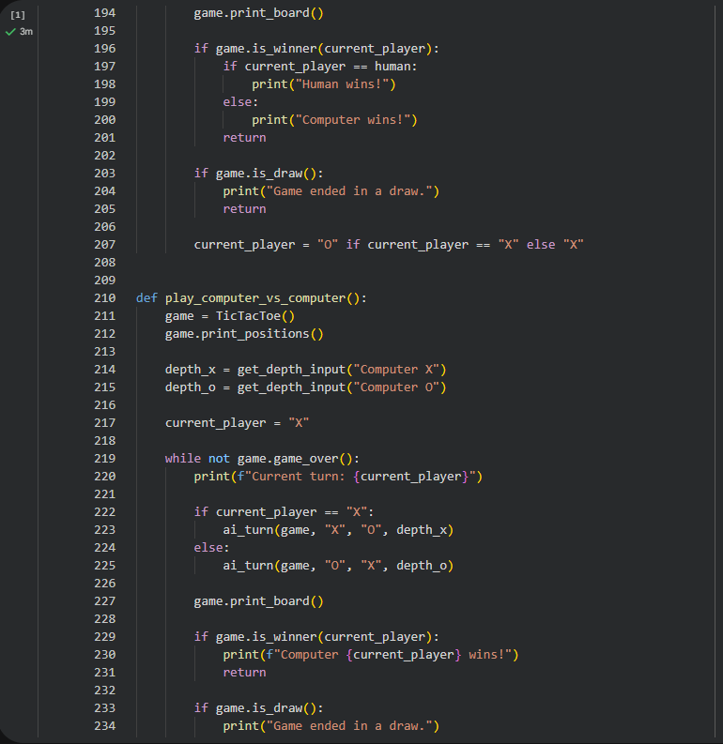

Slide 9
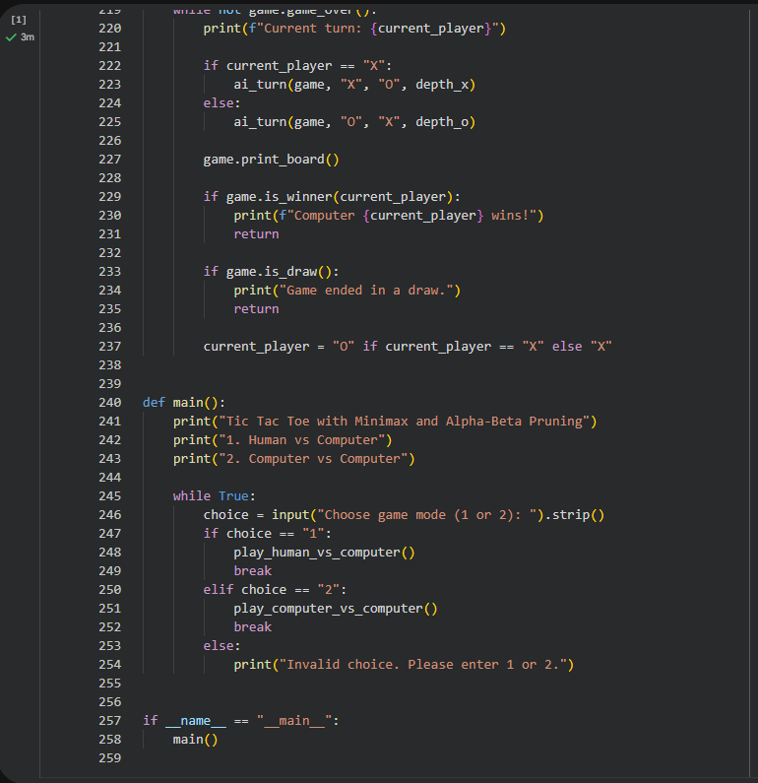

Slide 10
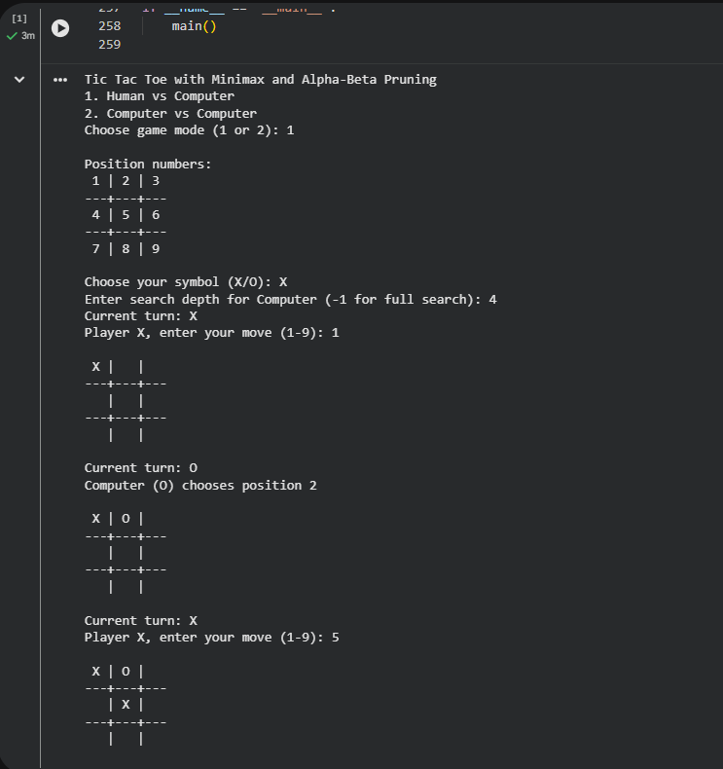
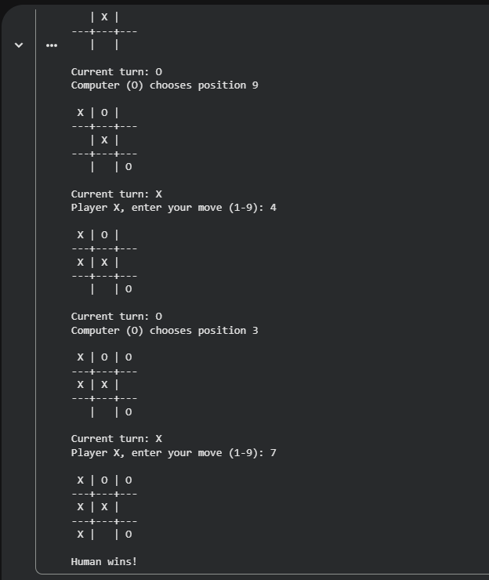
Output:

Slide 11
Comparison and Finding
Minimax algorithm always finds the best move but can be slow without optimization.
Alpha-beta pruning makes the algorithm faster by skipping unnecessary branches.
Both methods give the same final result, but alpha-beta uses less time and computation.
The AI performs perfectly with full search depth and never loses the game.

Slide 12
Conclusion and Challenges
Conclusion:
In this project, the Tic tac Toe game was successfully implemented using the minimax algorithm and alpha-beta punning. The AI player can make smart and optimal decisions based on the current game state. If full search is used, the AI will never lose.
The program is simple easy to use, and works correctly in both human vs Computer and Computer vs computer modes. This project helped in understanding game logic, recursion, and decision-making algorithm.
Challenges:
Understanding the minimax algorithm was difficult at first, especially how recursion works.
Implementing alpha-beta pruning correctly was challenging, because wrong placement can give wrong results.
Managing board states using undo moves was important to avoid errors during recursion.
Handling user input properly (like invalid moves or wrong input) was also a challenge.
Choosing the right depth for the AI was tricky, because low depth gives weaker performance.

Slide 13
Thank You

